Slide 1


Multi-Label Movie Genre Classification
Shashank V. Maiya
Data Science Intensive Capstone Project
October 1, 2018 Cohort

Slide 2
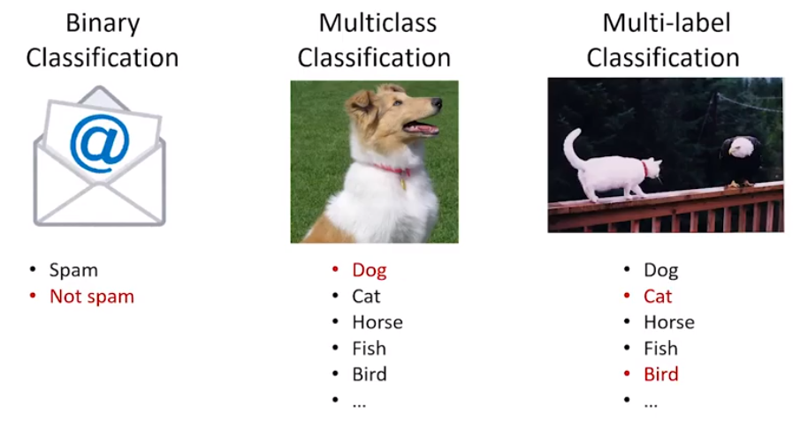
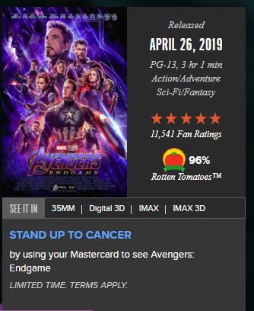
Types of Classification Tasks
Binary Classification: Only 2 choices
Multi-class Classification: Each observation is assigned to one and only one class
Multi-label Classification: Each observation can be classified into multiple classes

Slide 3
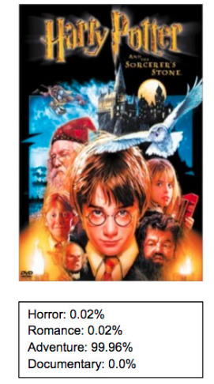
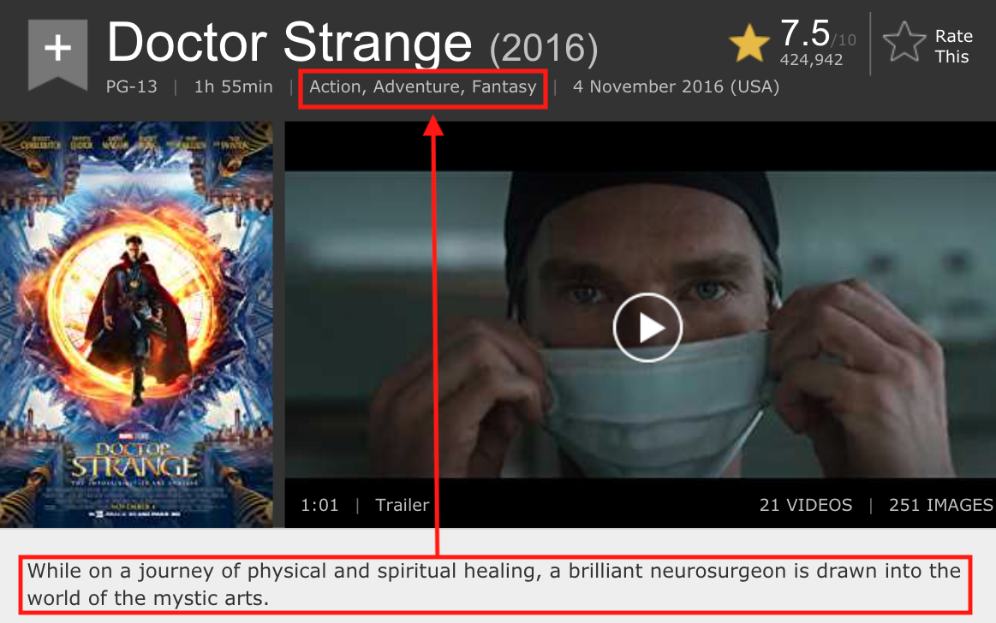

Multi-Label Classification - Applications
Multi-Label Classification of Movie Genre using Plot
Multi-Label Classification for Image/Scene Categorization
Multi-Label Classification of Genres based on movie Posters

Slide 4
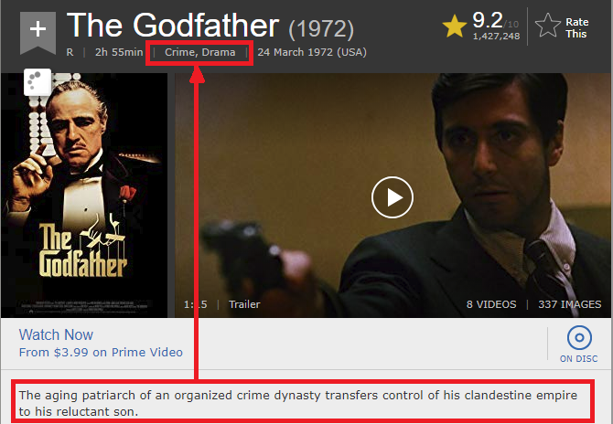
Prediction Problem
Given the plot of the movie, what are the genres they fall into?
Total of 27 Possible Genres
Movies are classified anywhere from 1 to 12 genres

Slide 5









Who might care?
Online Streaming Companies
Movie Review Websites

Slide 6
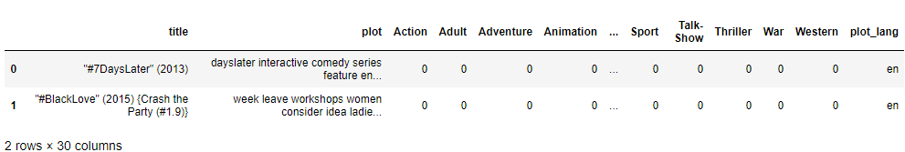
Data Overview
Data set obtained from IMDB
Number of movie data = 117,194
Column Description
Movie Title
Plot Language
Movie Plot
27 Movie Genres

Slide 7

Exploratory Data Analysis (EDA)

Slide 8
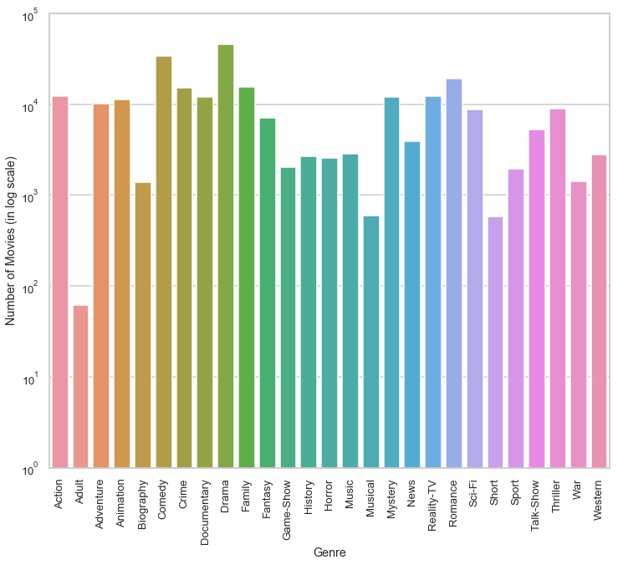
Number of Movies per Genre
Highest Genre Movies = Drama (45891) followed by Comedy (33870)
Lowest Genre Movies = Adult (61)

Slide 9
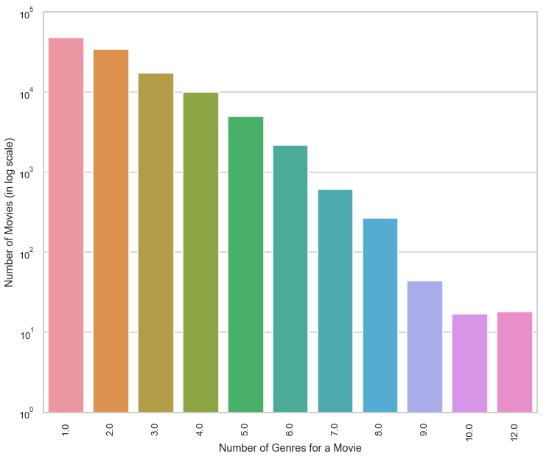
Number of Genres per Movie
Most movies are categorized with 1 or 2 genres
Average of 2.1 genres per movie
18 movies are classified using 12 genres!

Slide 10
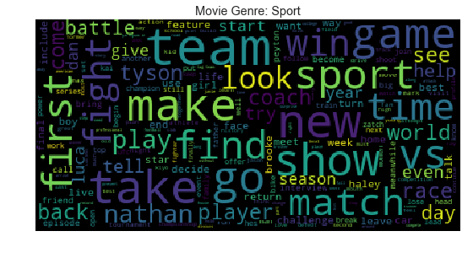
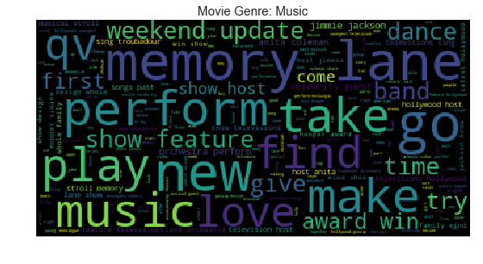
Word Cloud plots – [Sports, Music]
Relevant words – ‘team, vs, sport, first, match, player, race’
Relevant words – ‘memory, lane, perform, play, love, award, show’

Slide 11
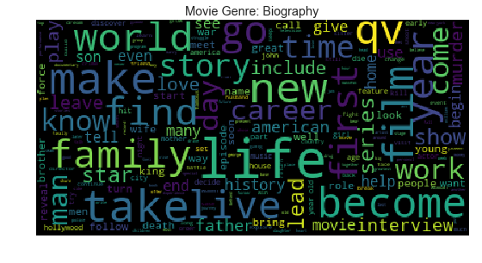
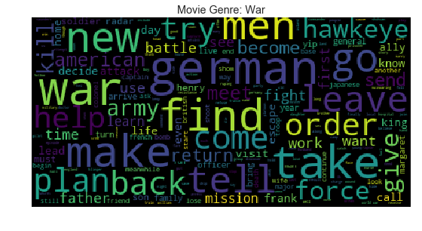
Word Cloud plots – [Biography, War]
Relevant words – ‘life, career, world, story, interview’
Relevant words – ‘german, order, plan, kill, mission, american’

Slide 12
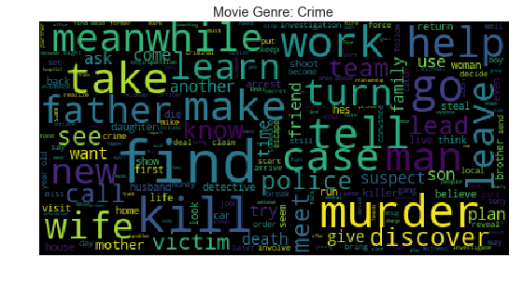
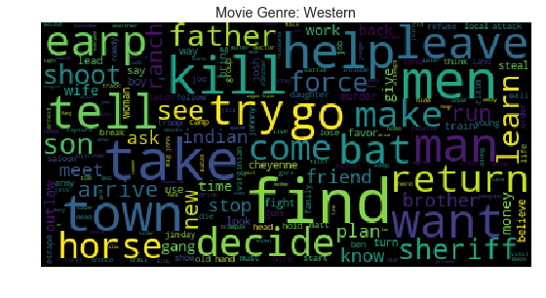
Word Cloud plots – [Crime, Western]
Relevant words – ‘kill, murder, case, police, victim’
Relevant words – ‘horse, sheriff, town, kill, Indian, gang’

Slide 13
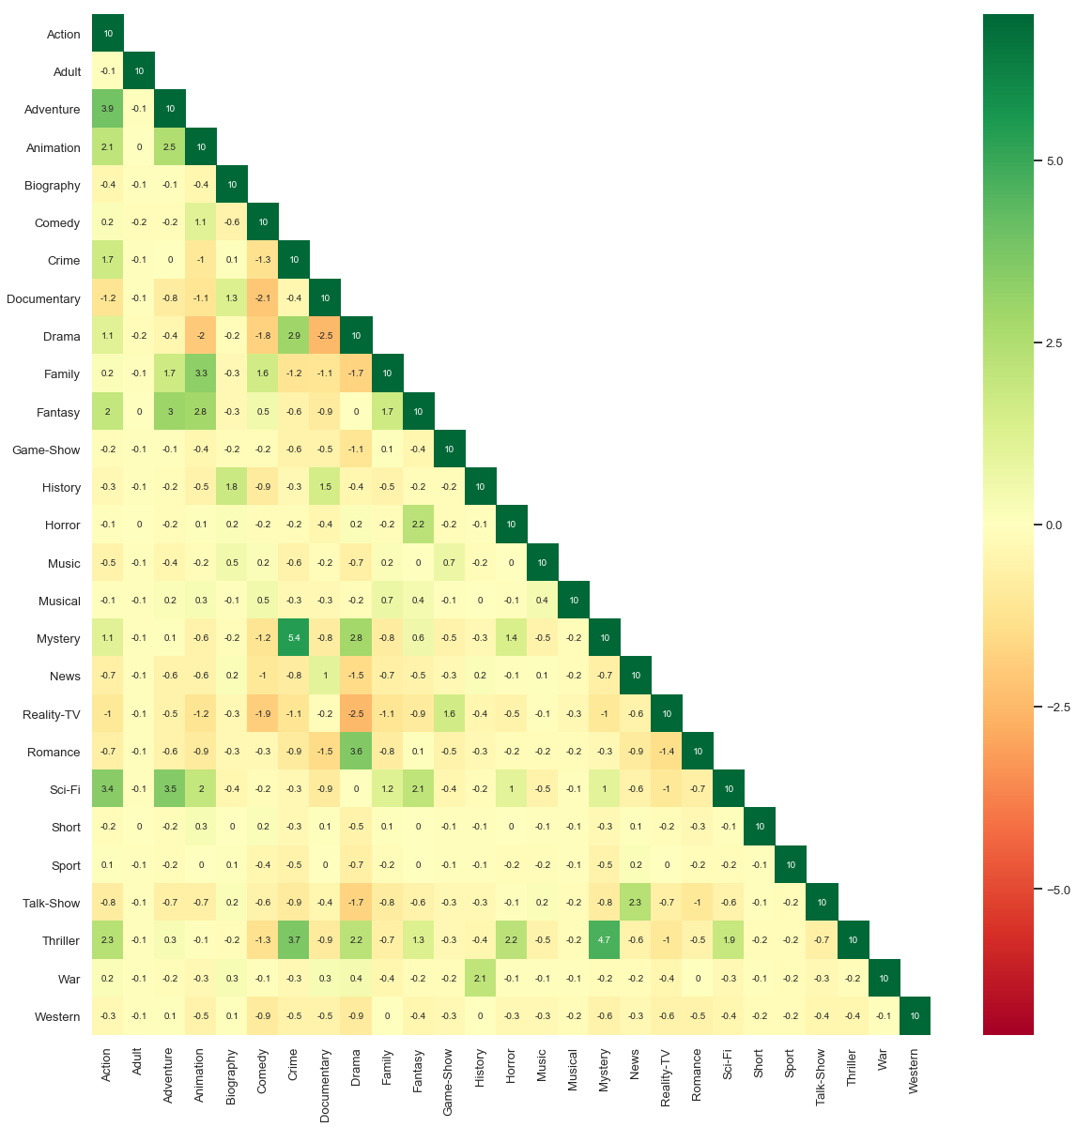
Correlation Analysis - Heatmap
Genres with strong positive correlation
Action, Adventure, Fantasy & Sci-Fi
Animation, Fantasy & Family
Crime, Thriller, Mystery & Drama
Drama & Romance
Game-Show & Reality-TV
War & History
Genres with strong negative correlation
Animation & Drama
Comedy & Documentary

Slide 14
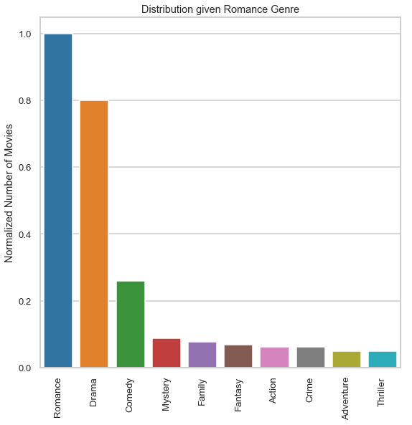
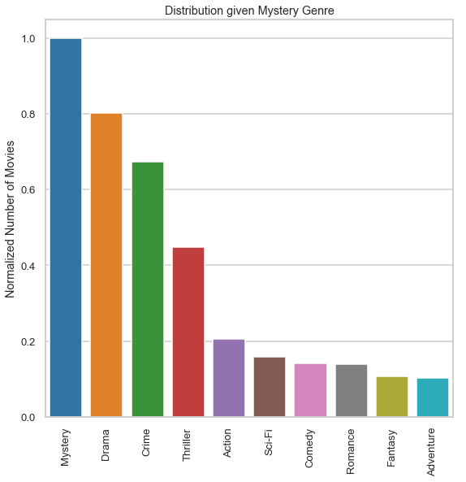
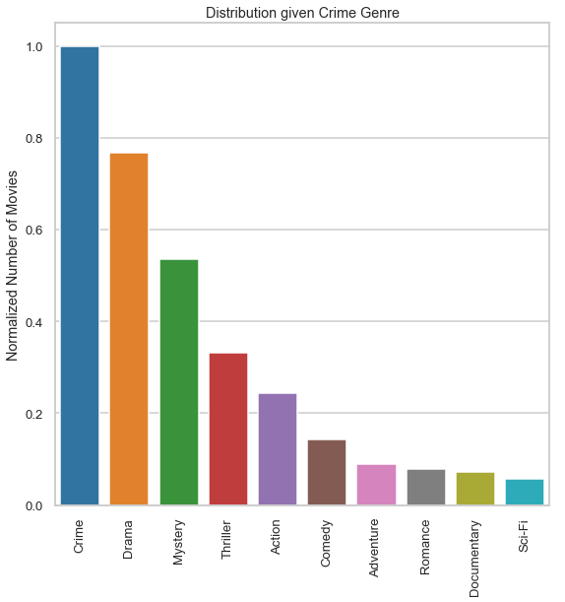
Multi-Genre Distribution Plots
80% of the Romance, Mystery& Crime movies are also categorized as Drama

Slide 15
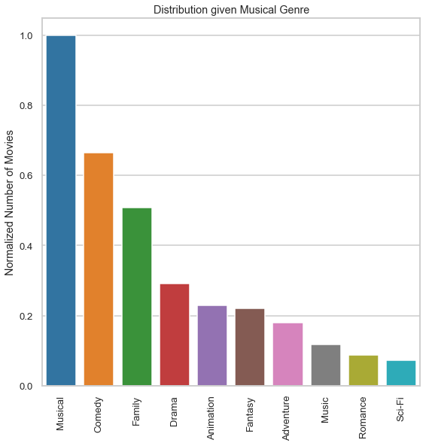
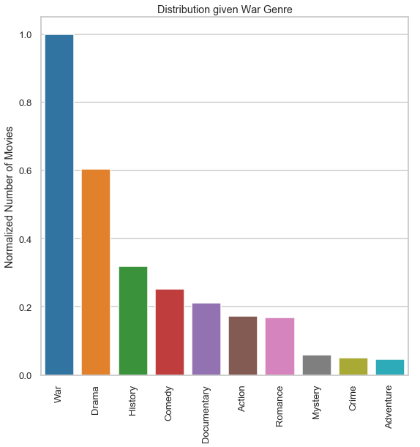
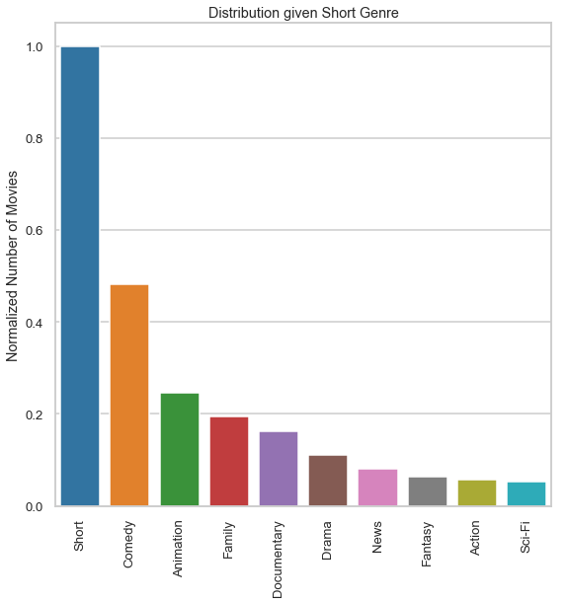
Multi-Genre Distribution Plots
65% of Musical movies are Comedy, 60% of War movies are Drama, Half of Short movies are Comedies

Slide 16
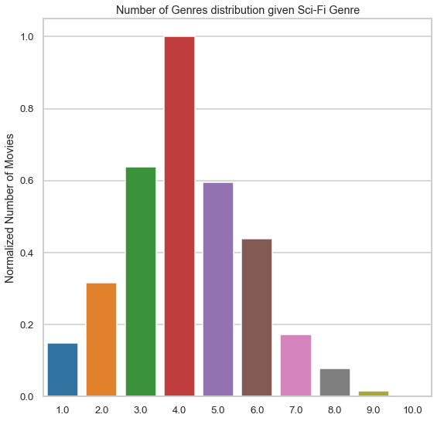
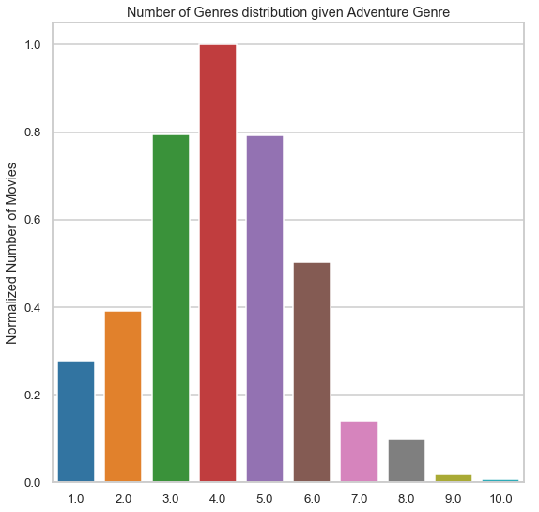
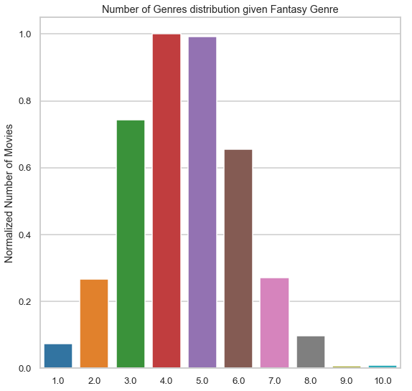
Number of Genres for [Sci-Fi, Adventure, Fantasy]
Movies categorized as Sci-Fi, Adventure or Fantasy are categorized into 3 to 6 categories

Slide 17
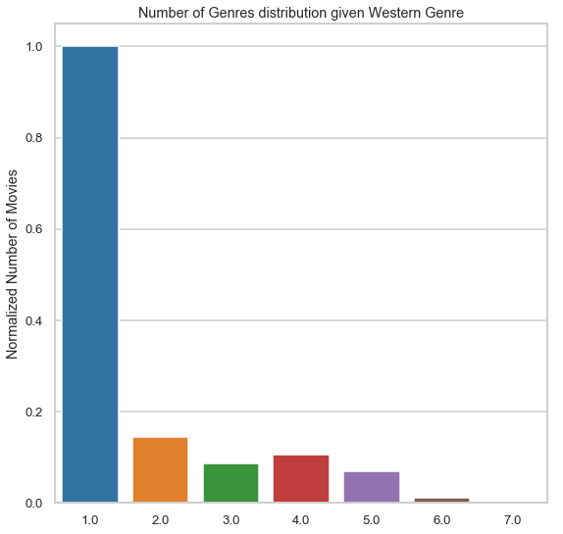
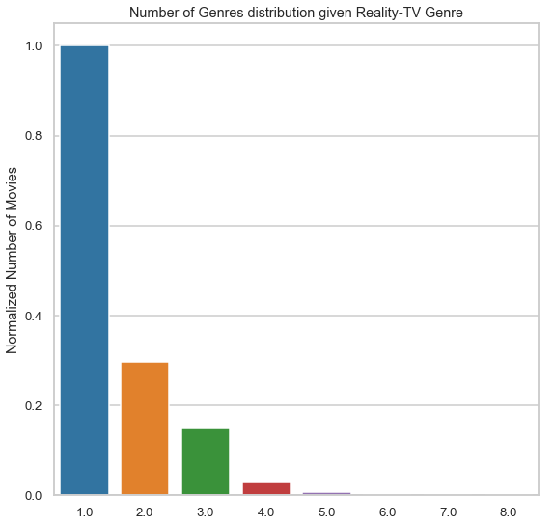
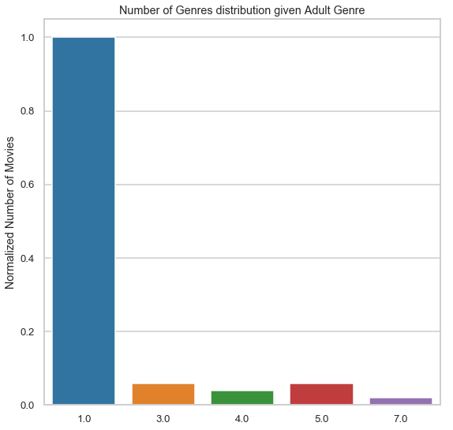
Number of Genres for [Western, Reality-TV, Adult]
Movie categorized as Western, Adult or Reality-TV are typically categorized to a single genre

Slide 18
Modeling

Slide 19
Modeling Overview
Type: Supervised Learning
Classification (Multi-label) Problem with 27 labels
Pipeline consists of
Encoder
Classification Model

Slide 20
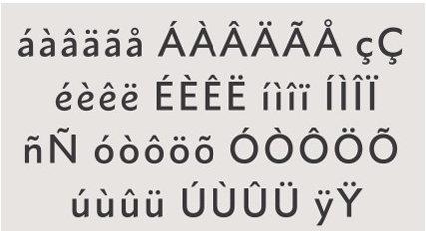
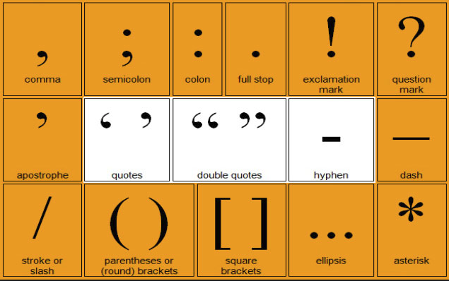
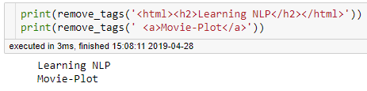
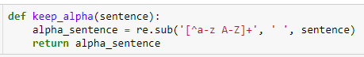
Text Preprocessing
Convert accented characters to ASCII
Remove HTML Tags
Remove Punctuations
Keep only alphabetic strings

Slide 21
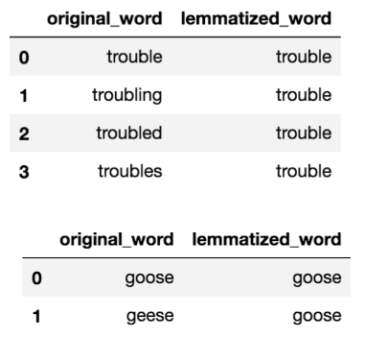
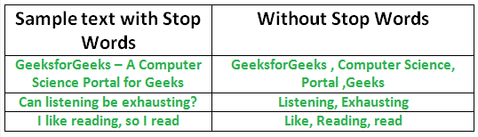
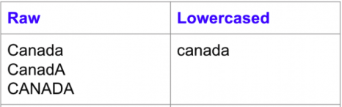
Text Preprocessing
Stop words removal
Lower casing all the words
Lemmatization

Slide 22
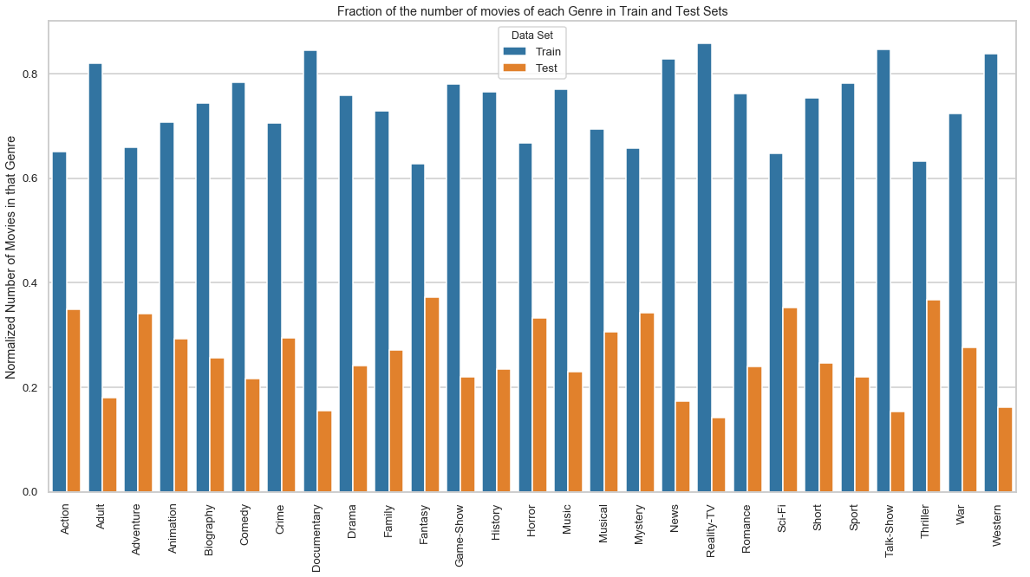
Train/Test Split
Imbalanced Data with genre occurrences ranging from 61 (Adult) to 45891 (Drama)
Train/Test split such that
At least 60% of the samples in the training set
At least 15% of the samples in the test set

Slide 23
Evaluation Metric – Overall F1 Score
For each Genre
$$Precision \left(Action\right)=\frac{Number of movies ‘correctly’ identified as Action Genre}{Total number of movies that have been identified as Action Genre}$$
Precision (Action)=(Number of movies ‘correctly’ identified as Action Genre)/(Total number of movies that have been identified as Action Genre)
$$Recall \left(Action\right)=\frac{Number of movies ‘correctly’ identified as Action Genre}{Total number of Action Genre movies in the data set}$$
Recall (Action)=(Number of movies ‘correctly’ identified as Action Genre)/(Total number of Action Genre movies in the data set)
$$F1 score \left(Action\right)=\frac{2∗Precision\left(Action\right)∗Recall(Acation)}{Precision\left(Action\right)+Recall(Action)}$$
F1 score (Action)=(2∗Precision(Action)∗Recall(Acation))/(Precision(Action)+Recall(Action))
Overall F1 Score = Weighted Average of individual Genre F1 Score

Slide 24
Multi-Label Algorithm + Text Encoder + Classifiers
Multi-Label Algorithm
Binary Relevance
Label Powerset
Text Encoder
Count Vectorizer
TF-IDF
Classifiers
Logistic Regression, Linear SVC, Naïve Bayes
Cosine Similarity
Sentence Embedding
Neural Networks
Label Powerset with Clustering

Slide 25
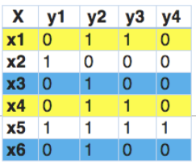
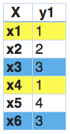
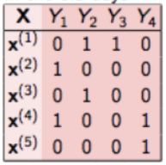
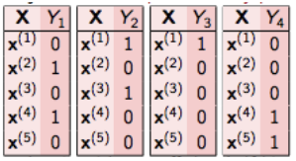
Multi-Label Classification Algorithms
Binary Relevance
Treat each label as a separate single class Classification
27 Genres ➔ 27 Binary Classifiers
Label Powerset
Treat each of the unique genre combinations found in the training data as a possible class
1505 Unique genre combinations ➔ Multi-class classification with 1505 classes
Label Powerset with Clustering
Reduce the number of genre combinations by clustering (from 1505 to 75)

Slide 26
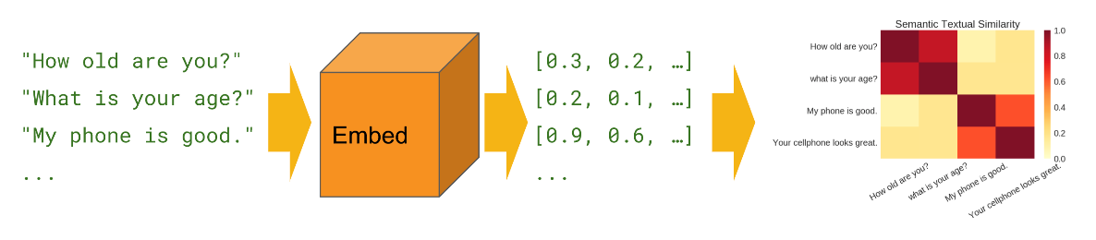
Text Encoder – Sentence Embedding
Google Universal Sentence Encoder (USE) converts input sentence to 512 dimension numeric vectors
Preserves the semantic meaning of the sentence

Slide 27
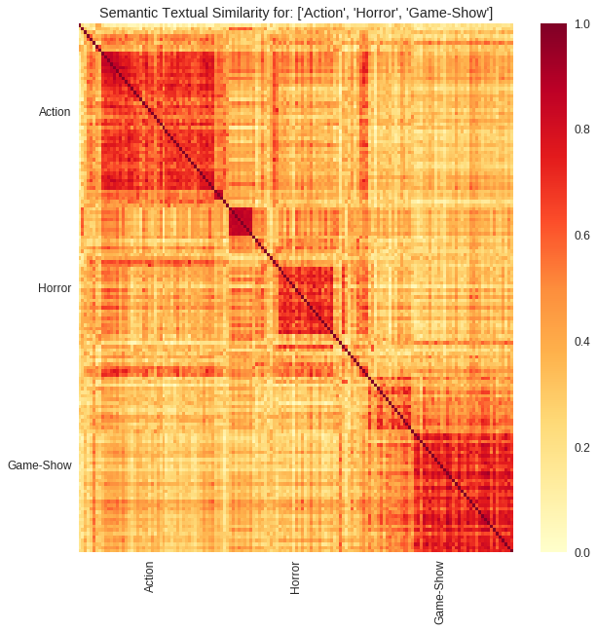
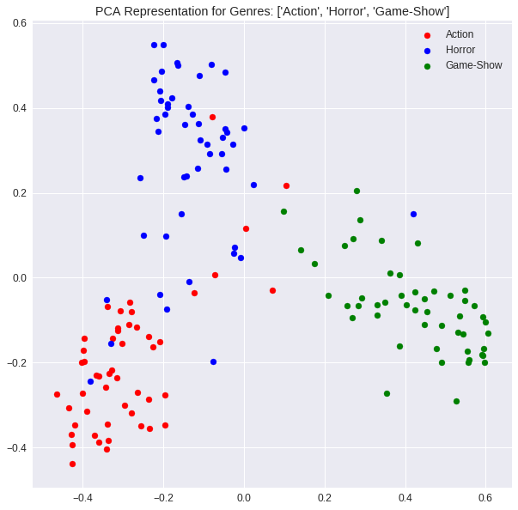
Sentence Embedding – [Action, Horror, Game-Show]

Slide 28
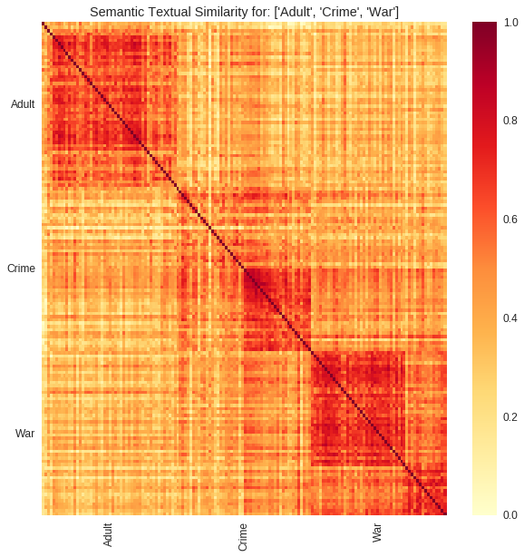
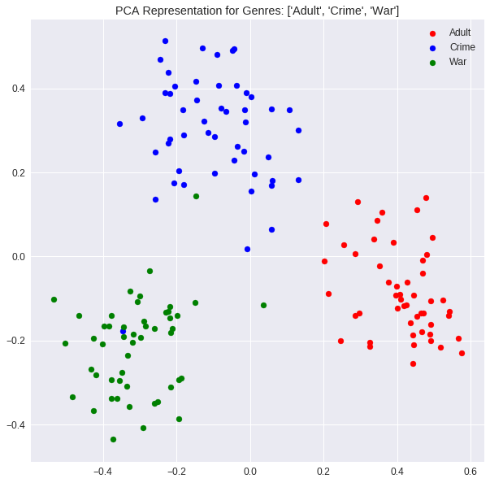
Sentence Embedding – [Adult, Crime, War]

Slide 29
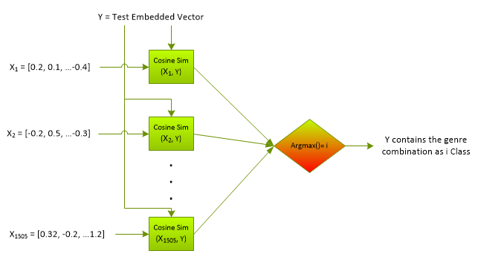

Classification Models – Cosine Similarity
Sentence Embedding of similar genres cluster together
Cosine Similarity$\left(\vec{x}, \vec{y}\right)=$
$\frac{\vec{x}⋅\vec{y}}{\left|\left|\vec{x}\right|\right| \left|\left|\vec{y}\right|\right|}=\frac{\sum_{i=1}^{512}{x_{i}y_{i}}}{\sqrt{\sum_{i=1}^{512}{x_{i}^{2}}} \sqrt{\sum_{i=1}^{512}{y_{i}^{2}}}}$

Slide 30
Classification Models – Neural Network
Using Binary Relevance
Each Genre predicted separately ➔ Output Layer = 27 Neurons
Use sigmoid Activation Function
Using Label Powerset
Output Layer = 1505 Neurons
Use softmax Activation Function since a single class is predicted

Slide 31
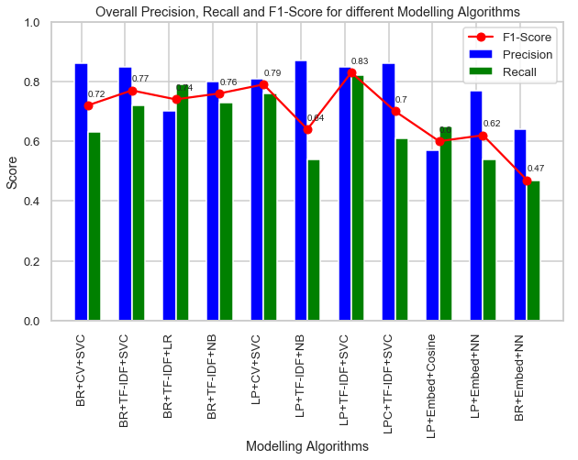
Result Summary
Best predicting Model: Label Powerset + TF-IDF + Linear SVC (Overall F1-Score = 0.83)
Models using Sentence Embedding performance is worse compared to other Vectorizers and ML models
BR: Binary Relevance
LP: Label Powerset
LPC: Label Powerset with Clustering
CV: Count Vectorizer
Embed: Sentence Embedding via USE
SVC: Linear Support Vector Classifier
LR: Logistic Regression
NB: Naïve Bayes
Cosine: Cosine Similarity
NN: Neural Networks

Slide 32
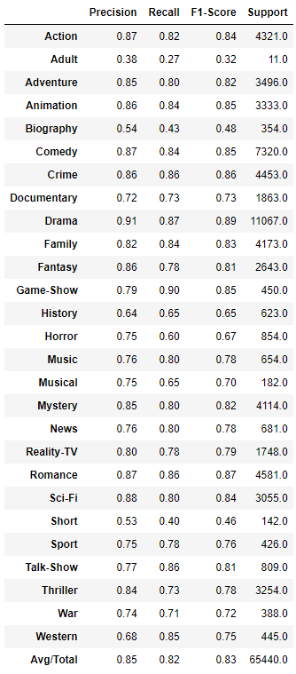
Label Powerset + TF-IDF + Linear SVC
Hyperparameters
TF-IDF
Ngram = (1, 2)
Min_df = 2
Max_df = 0.5
LinearSVC
C = 10
Overall F1-score = 0.83
Poorest performing Genre = Adult
F1-score = 0.32, but only 11 samples

Slide 33
Conclusions
Out of the 11 models considered, the best predicting model uses TF-IDF Vectorizer, Linear Support Vector Classifier and Label Powerset approach to achieve an overall F1-score of 0.83
Sentence Embedding doesn’t provide any benefit (yet)
EDA specific Observations
Drama and Comedy the most popular Genre
On an average, a movie is classified into 2 genres (and a maximum of 12 genres)
Few strongly correlated genres include – a) Crime, Mystery & Thriller, b) Drama & Romance
80% of Romance, Crime, Mystery and Thriller movies are also categorized as Drama

Slide 34
Limitations and Ideas
Improving Sentence Embedding
Sentence embedding doesn’t require the sentence lemmatization, or stop word removal, or in fact any of the text preprocessing steps. Use the original text before preprocessing to obtain sentence embedding
Use Sentence Embedding with Linear SVC (since Linear SVC was the best model)

Slide 35

Thank You!
Shashank V. Maiya
Email: shashank.maiya@gmail.com
Linkedin Profile: https://www.linkedin.com/in/shashankmaiya/
Github: https://github.com/shashankvmaiya/Movie-Genre-Multi-Label-Text-Classification
Project Report: Final_Report.pdf

